Slide 1
Machine Learning Techniques Applied to IR
Jason Casey
Office of Strategic Planning and Institutional Research
University of Notre Dame
NEAIR 2016
Baltimore, Maryland

Slide 2
Background
Traditional social science background
Several predictive projects that were challenging
Factors related to academic risk
Prediction of US News Law School Rankings
Factors related to placement of PhD’s
The presentation relates some of what I’ve learned THUS FAR

Slide 3
Social Science
Addition to the body of knowledge
Propose hypotheses
Carefully choose variables
Test fit, arrive at a parsimonious model
Explanation matters
HIGHLY supervised process

Slide 4
Machine Learning
Variable selection is not necessarily theory-based
Process is less supervised
Explanation is less important, sometimes unimportant
Accurate prediction is the goal

Slide 5
Classification Techniques
Not covered in depth here
Machine learning has deep roots in prediction of discrete things (events, signal analysis, etc.)
Include Classification Trees, Random Forests, and Support Vector Machines

Slide 6
Regression Techniques
This presentation will focus on continuous outcomes
Generalizations of discrete methods

Slide 7
A Few Observations…
In general, when you have a linear relationship, Linear Regression produces the most accurate and parsimonious model
Linear regression is prone to overfitting
For large datasets (i.e. truly BIG data), inferential statistics become less useful
Because machine learning methods are less focused on explanation, the output tends to be less informative than traditional regression

Slide 8
More Observations
Machine learning models tend to handle non-linear data better
They can also do a better job handling outliers
Machine learning techniques that use bagging better control for multi-collinearity
…and therefore, permit a kitchen sink approach to variable selection

Slide 9
Classification and Regression Trees
CART in a nutshell:
“Glass box” method
Divide cases into terminal nodes or “leaves” using a series of yes/no questions of the best predictor variables of a given outcome
Train on training set(s) and validate on testing set(s) to reduce overfitting
Uses both categorical and continuous factors easily
The classification tree is used for categorical outomes, regression for continuous outcomes

Slide 10
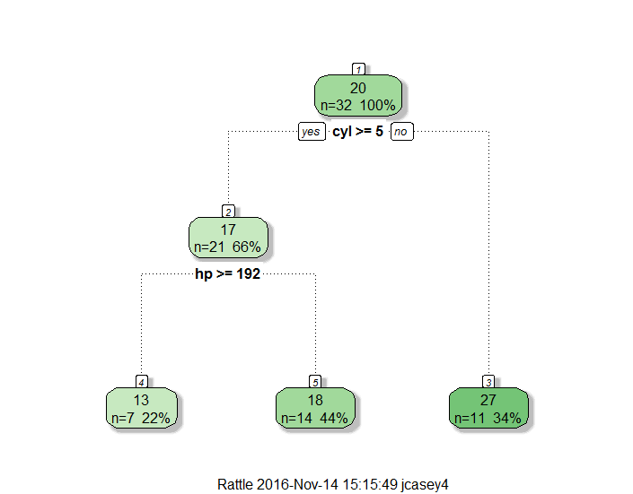
An Example
Node number 3: 11 obs
mean=26.66
MSE=18.49
Node number 4: 7 obs
mean=13.41
MSE=4.12
Node number 5: 14 obs
mean=18.26
MSE=4.28

Slide 11
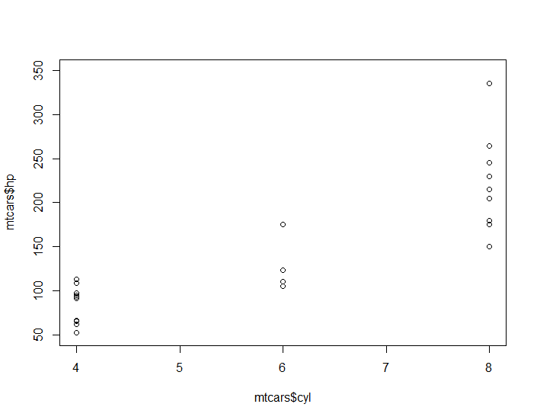
Prediction: Grid of Means
Mpg = 26.6
Mpg = 13.41
Mpg = 18.26

Slide 12
CART vs. Linear Regression
Regression makes point estimates, CART panel estimates
CART handles large numbers of predictors (including interactions) better
Presentation of trees is more intuitive for non-technical audiences
CART is inefficient and prone to overfitting

Slide 13
Random Forests
Random Forest = ensemble method
Single trees have flaws; over many iterations using various combinations of cases and variables (bagging), flaws tend to “average themselves out”
Using Out-Of-Bag (OOB) observations for testing on each iteration, the method does internal cross validation

Slide 14
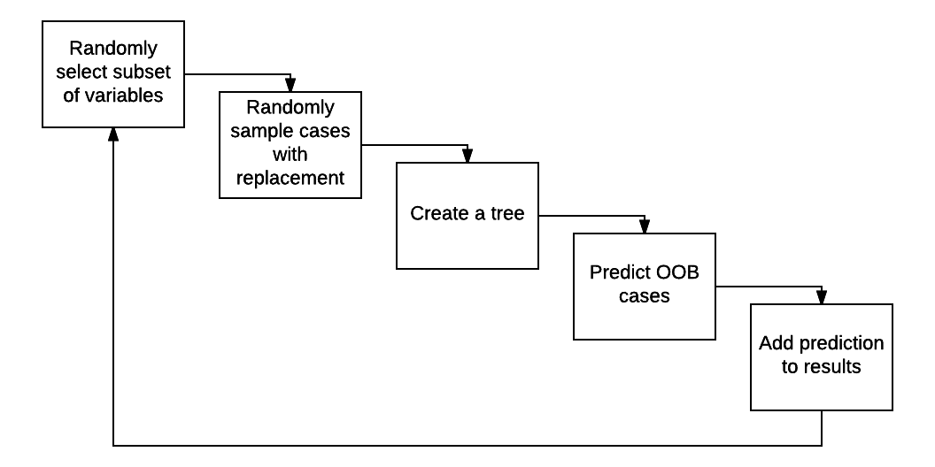
Random Forests

Slide 15
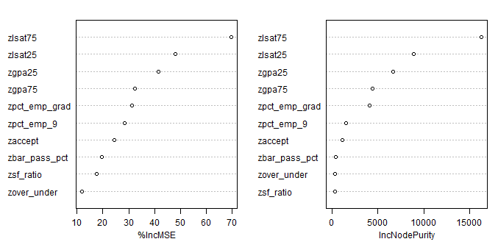
Random Forest Output

Slide 16
Random Forests vs. Linear Regression
Linear regression produces more detailed output
Linear regression tends to handle parsimonious linear models well
Random Forests handle MASSIVE numbers of predictors
Random Forests tend to even out the effects of outliers, aberrant samples, and the like
Random Forests are less prone to overfitting

Slide 17
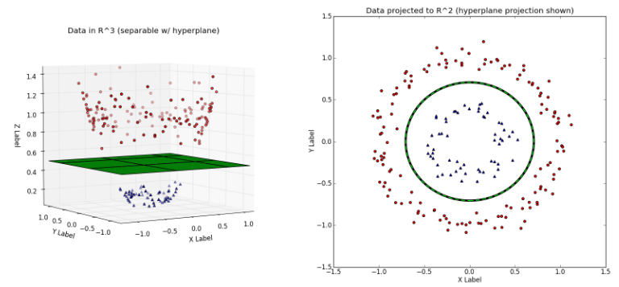
What is Support Vector Regression?
An application of Support Vector Machines (SVM)
SVM attempts to find a hyperplane that correctly predicts classes (SVM) or scores (SVR).

Slide 18
SVR vs. Linear Regression
Linear Regression: reduction of squared errors
SVR: optimal hyperplane with widest decision boundary possible
Like Linear Regression, categorical predictors (factors) must be transformed into vectors (dummy, effect, etc.) to be evaluated

Slide 19
Common Steps in SVR
Re-scale the data
Select initial kernel
Tune the model to optimize prediction
(Potentially) repeat with different kernels to improve prediction and/or reduce overfitting

Slide 20
Kernels
A kernel is a similarity function
Common kernel types:
Linear
Radial Basis
Polynomial

Slide 21
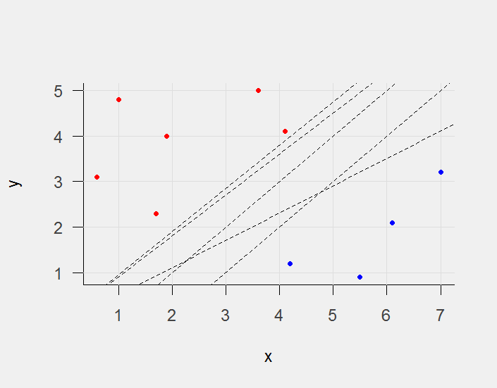
Many Planes, But Which One?

Slide 22
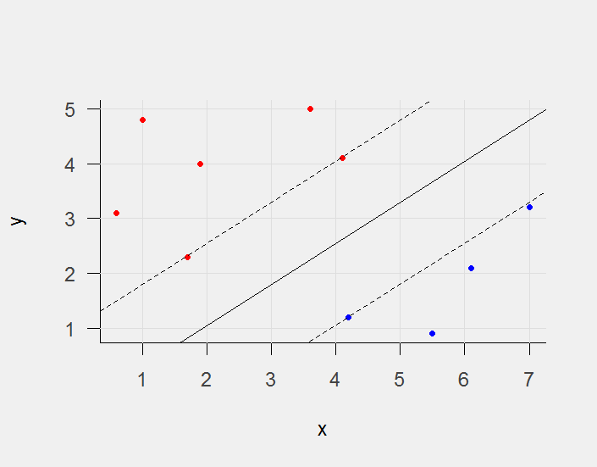
Support Vector Machine
Hyperplane that separates cases
The best hyperplane maximizes boundary between classes
Cases along boundary are support vectors

Slide 23
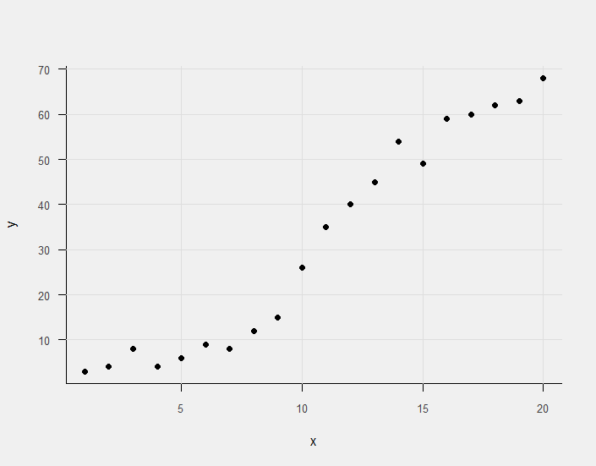
SVR vs. Linear Regression
Consider some non-linear data
SOURCE: http://www.svm-tutorial.com/2014/10/support-vector-regression-r/

Slide 24
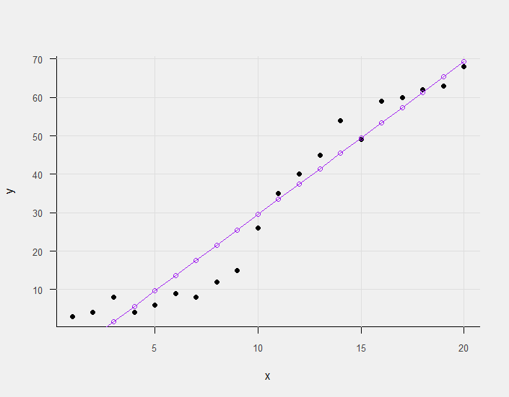
SVR vs. Linear Regression
Consider some non-linear data
A linear solution isn’t optimal

Slide 25
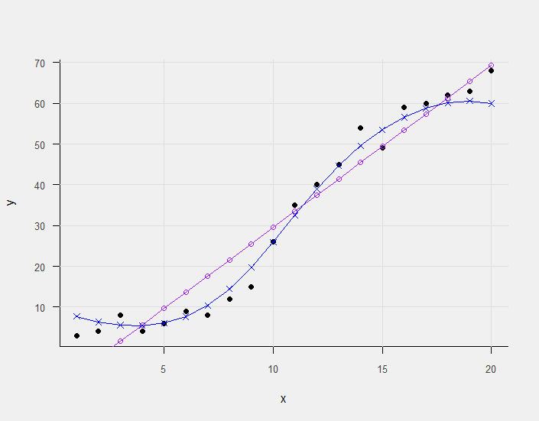
SVR vs. Linear Regression
Consider some non-linear data
A linear solution isn’t optimal
An un-tuned SVR using Radial Basis kernel

Slide 26
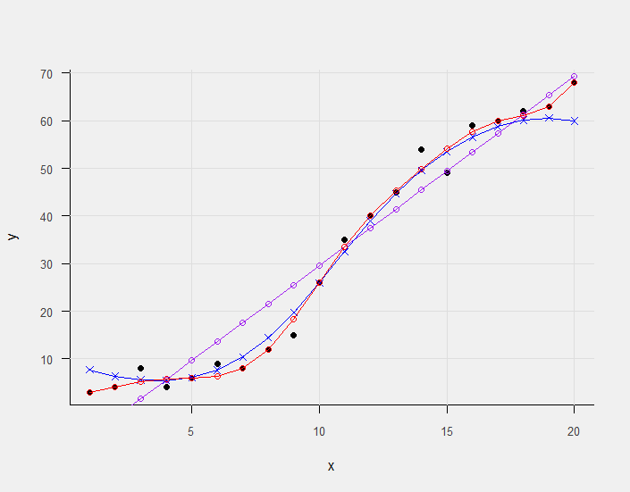
SVR vs. Linear Regression
Consider some non-linear data
A linear solution isn’t optimal
An un-tuned SVR using Radial Basis kernel
Tune the model

Slide 27
Points to ponder
Data quality
Beware of unintended consequences
How to present results?

Slide 28
Links
My source code and data:
https://github.com/jasonpcasey/neair-predictives
Excellent beginner’s guide on prediction in R:
http://trevorstephens.com/kaggle-titanic-tutorial/getting-started-with-r/
Support Vector Regression:
http://www.svm-tutorial.com/2014/10/support-vector-regression-r/

Slide 29

Thank You!

